Slide 1

Efficient Face Attendance Management: Implementing Deep Learning for Real-Time Recognition Project batch No: BATCH-9
DEPARTMENT OF AIML (AIM) – IV-II Sem Project Review
PROJECT GUIDE: K. Deepika
PROJECT BY:
TL: G.Tejaswini Sai(21BQ1A6121)
TM1: D.Vignesh Reddy( 21BQ1A6117)
TM2: A. Swathi ( 21BQ1A6102)
TM3: K.Ashreeth(21BQ1A6103)

Slide 2
AGENDA
ABSTRACT
OBJECTIVE
INTRODUCTION
AI/ML/DEEP LEARNING BASED METHODOLOGY TO SOLVE THE PARTICULAR PROBLEM
TOOLS IDENTIFIED
PROPOSED SYSTEM
EXECUTION
CONCLUSION

Slide 3
ABSTRACT
The Realtime Face Attendance System using ArcFace automates attendance marking with facial recognition. It captures and preprocesses images in real-time, ensuring high accuracy with the ArcFace algorithm.
✔️ Attendance is recorded automatically and stored in CSV format. ✔️ Data is visualized on a Streamlit dashboard for analysis. ✔️ Absentees receive automated email notifications.
This system offers a contactless, accurate, and scalable solution for modern attendance management.

Slide 4
OBJECTIVES
Aim of the Project:
The project aims to design and implement a real-time facial recognition-based attendance system using the Arcface algorithm. It seeks to automate attendance marking, streamline record-keeping, and enhance administrative efficiency with advanced AI/ML technologies.
Scope of the Project:
Applicable in educational institutions, corporate offices, and other organizations requiring attendance tracking.
Provides high accuracy and efficiency with real-time face recognition.
Offers scalability to integrate with other administrative systems for comprehensive management.
Reduces operational costs and improves accountability through automated notifications.

Slide 5
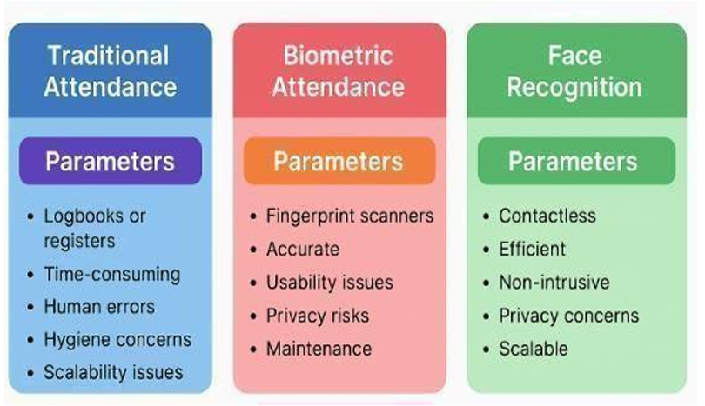
INTRODUCTION
Attendance management is a critical task in educational and organizational settings.
Traditional methods, such as manual or biometric systems, are often prone to errors and inefficiencies.
This project leverages the Arcface facial recognition algorithm to automate attendance tracking, providing a real-time, accurate, and user-friendly solution.

Slide 6
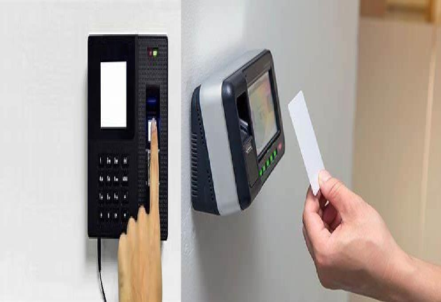
INTRODUCTION
Current attendance systems rely on manual or semi-automated methods that are time-consuming and error-prone.
There is a need for a real-time, accurate, and efficient solution that can handle attendance management without manual intervention, while also ensuring transparency and accountability.

Slide 7
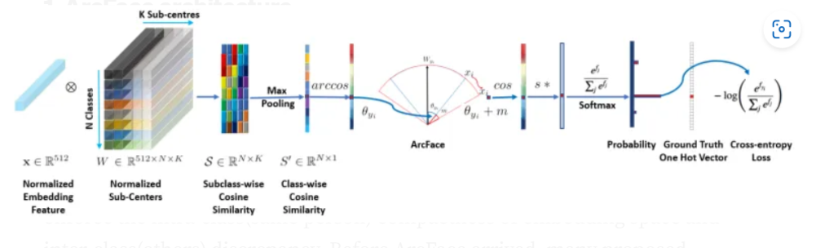
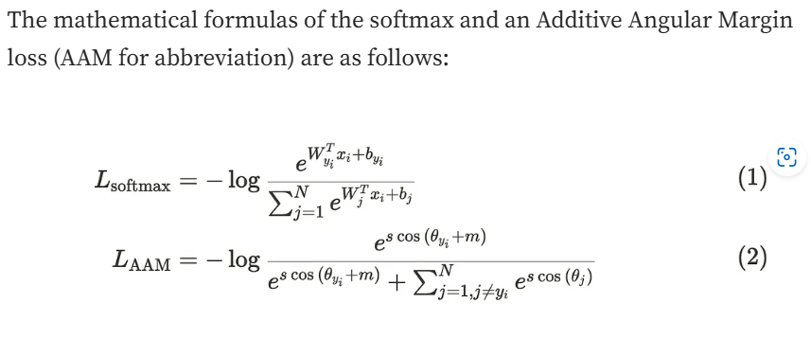
AI/ML/DEEP LEARNING BASED METHODOLOGY TO SOLVE THE PARTICULAR PROBLEM
Arcface: A state-of-the-art facial recognition algorithm that uses deep learning to achieve high accuracy in face recognition tasks. It ensures reliable identification even in varying lighting or facial angles, making it ideal for real-time applications.

Slide 8
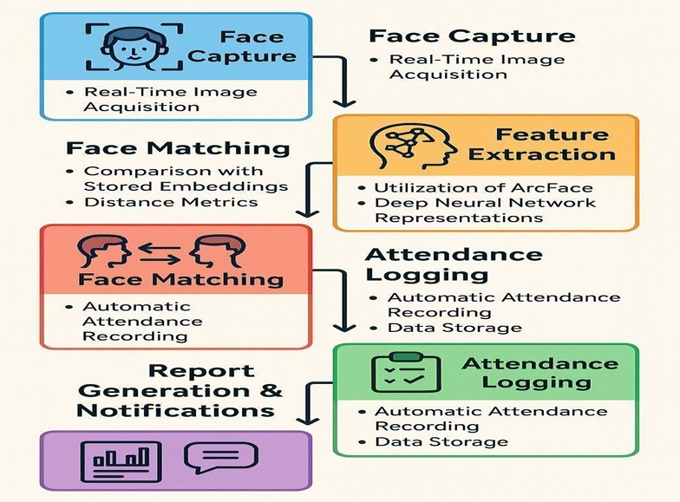

Slide 9
TOOLS
Python: Backend logic and processing.
Arcface: Facial recognition algorithm.
Streamlit: Interactive user interface and analytics dashboard.
OpenCV: Webcam integration and image preprocessing.
Pandas: Data manipulation and CSV storage.
SMTP Library: Email notifications for absentees.

Slide 10
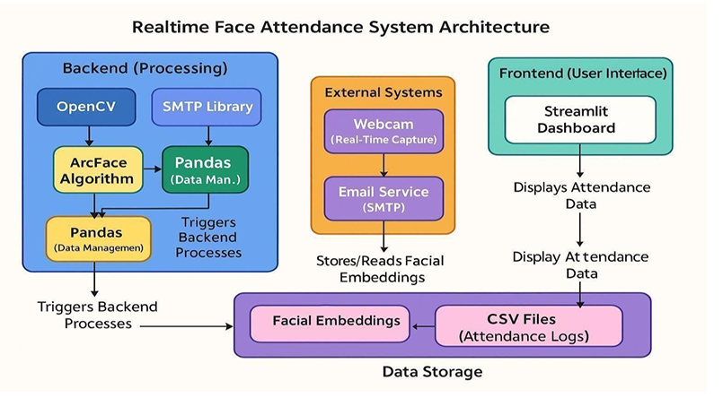
Proposed system

Slide 11
Proposed sytsem
Arcface Initialization
Setting up and loading the Arcface algorithm for face recognition.
Streamlit Application
Creating an interactive interface for capturing images, attendance tracking, and analysis.
Image Capture
Capturing student images in real-time using a webcam.
Image Preprocessing
Real-time preprocessing (resizing, normalization) of images for efficient model training.

Slide 12
Proposed system
5.Model Training
Training the Arcface model dynamically with real-time captured data.
6.Attendance Marking
Detecting and marking student presence or absence through facial recognition.
7.Data Storage
Storing attendance records in a CSV file for further analysis.
8.Attendance Analysis and Notification
A Streamlit-based page for visual analysis and sending emails to absent students.

Slide 13
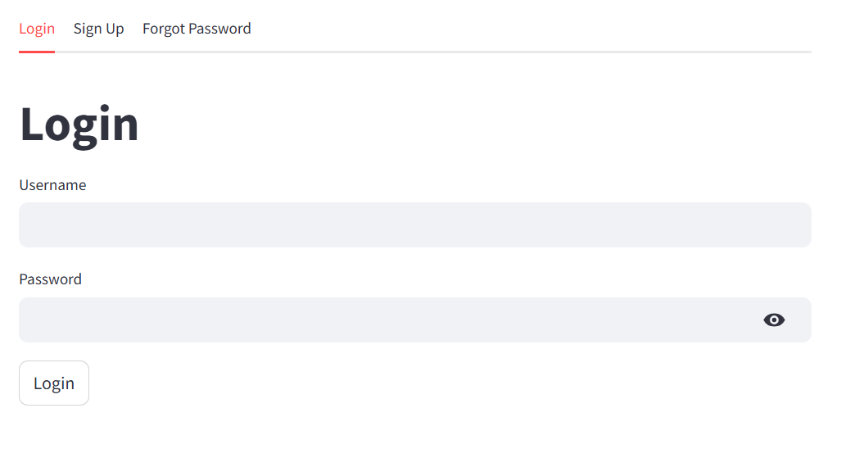
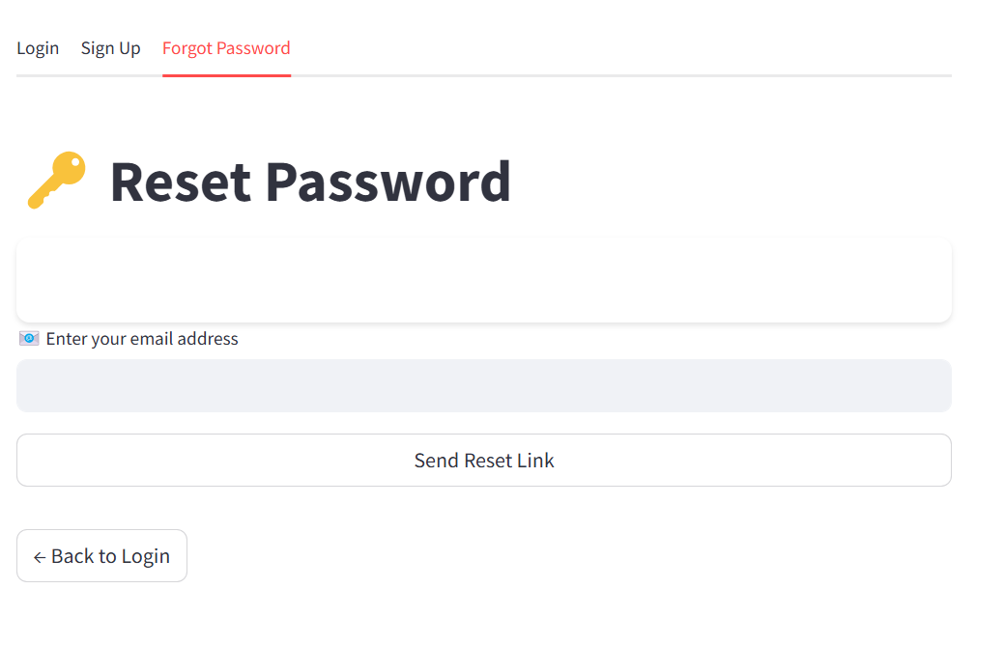
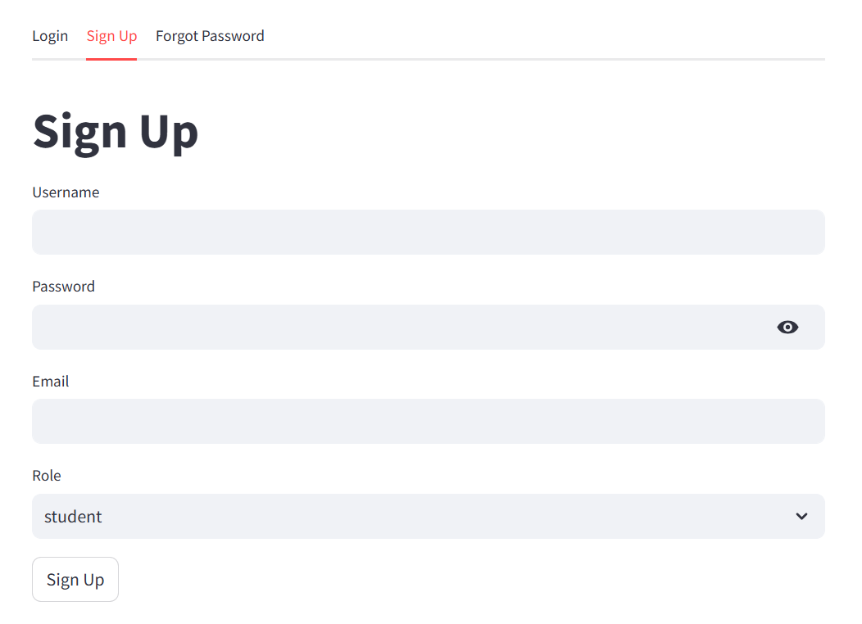
EXECUTION

Slide 14
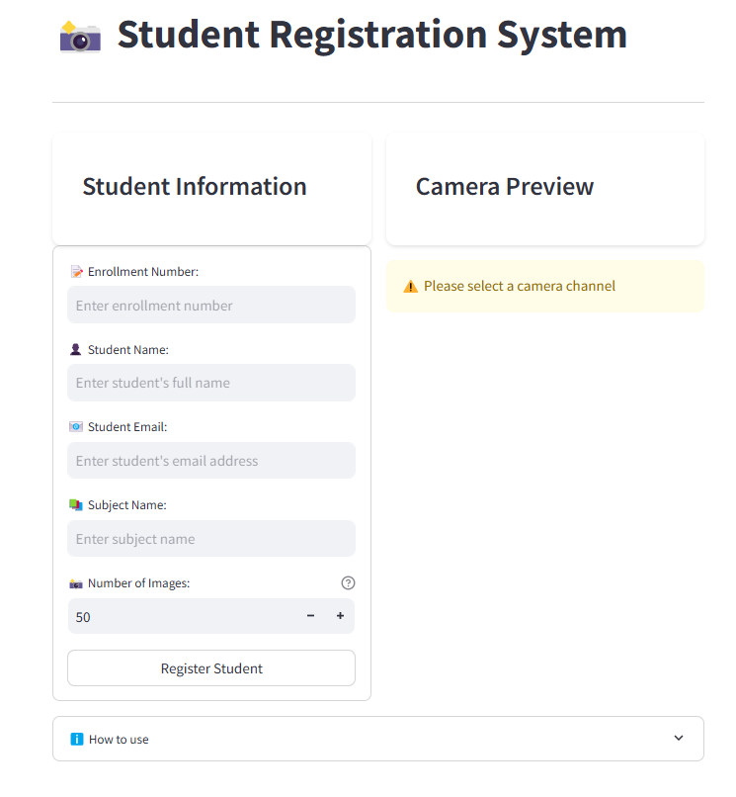
Data Collection :

Slide 15
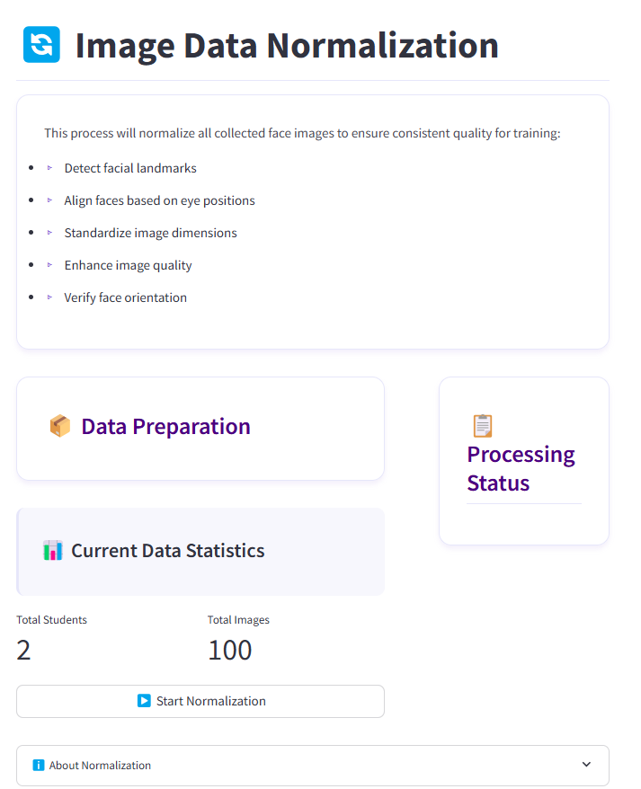
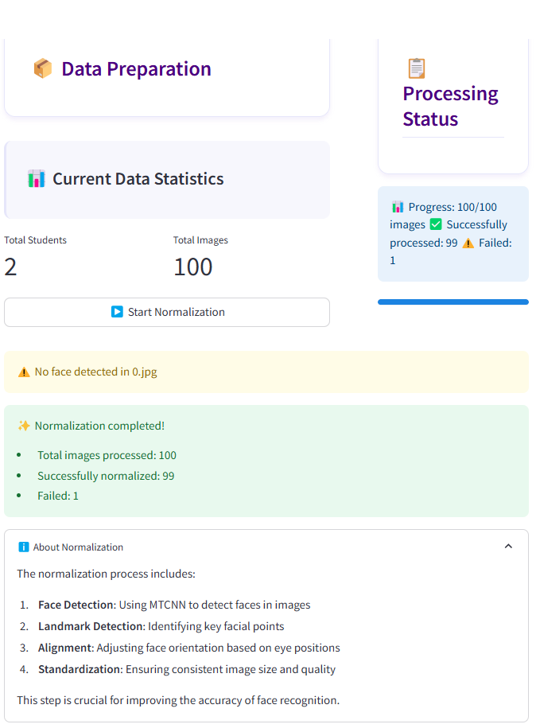
Normalize Data :

Slide 16
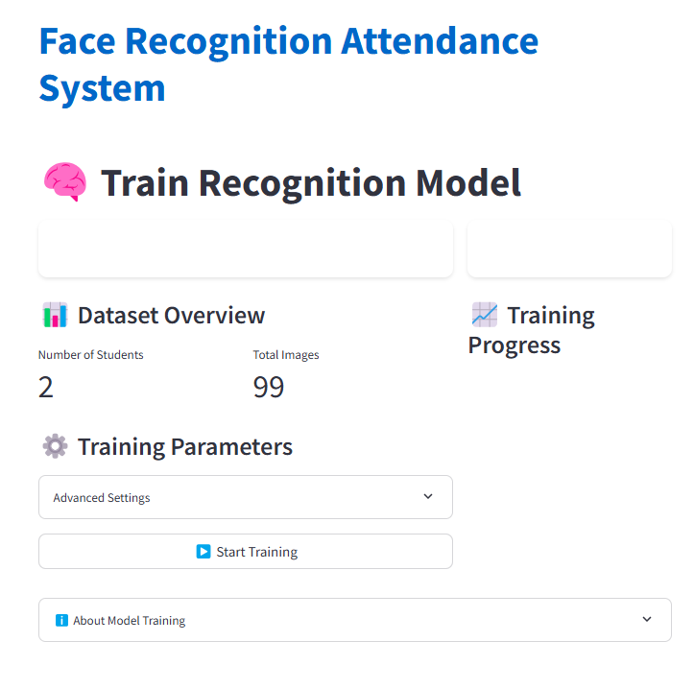
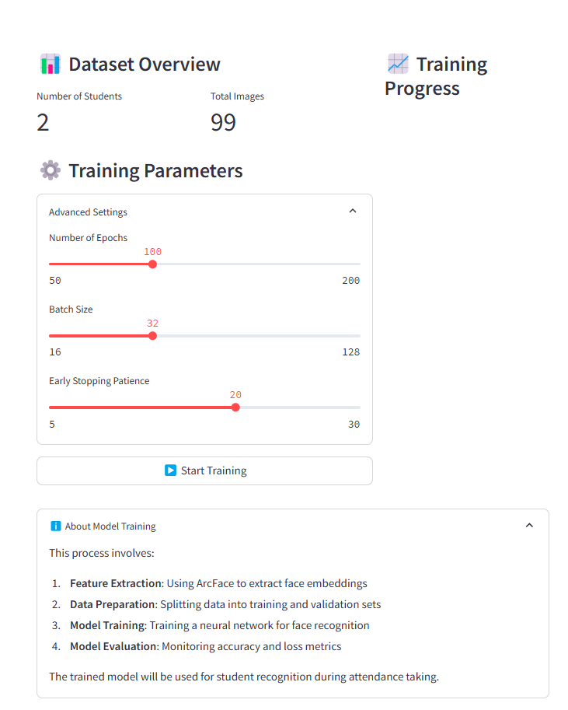
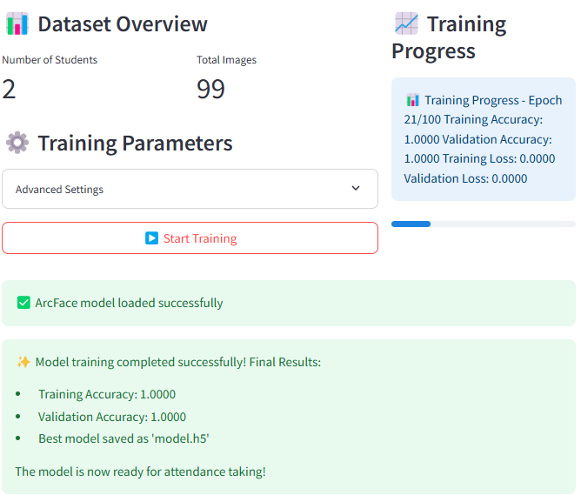
Training :

Slide 17
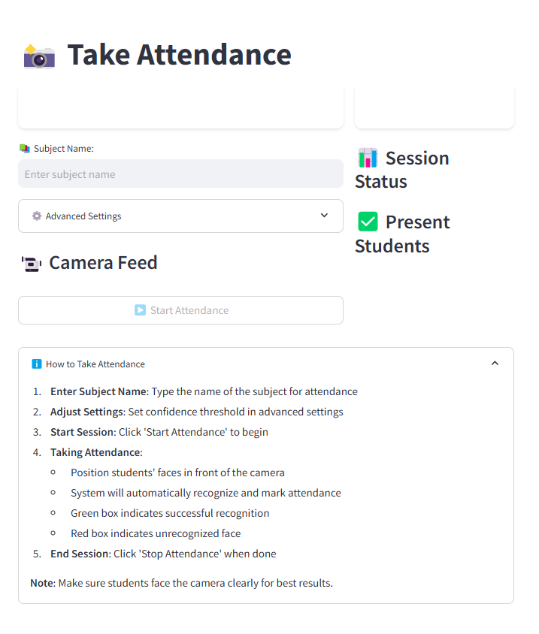
Take Attendance :

Slide 18
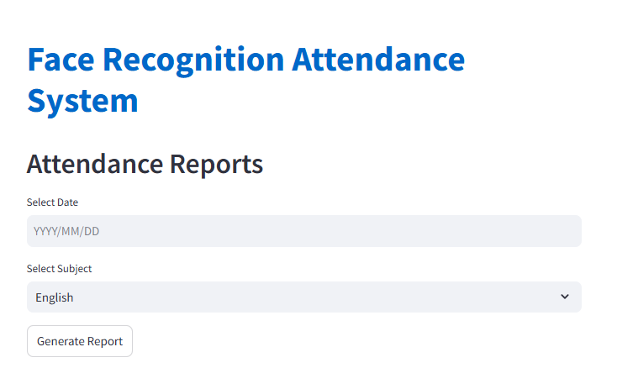
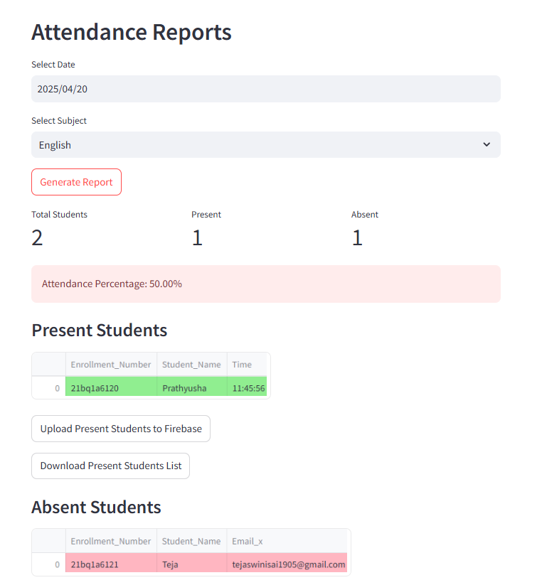
View Reports :

Slide 19
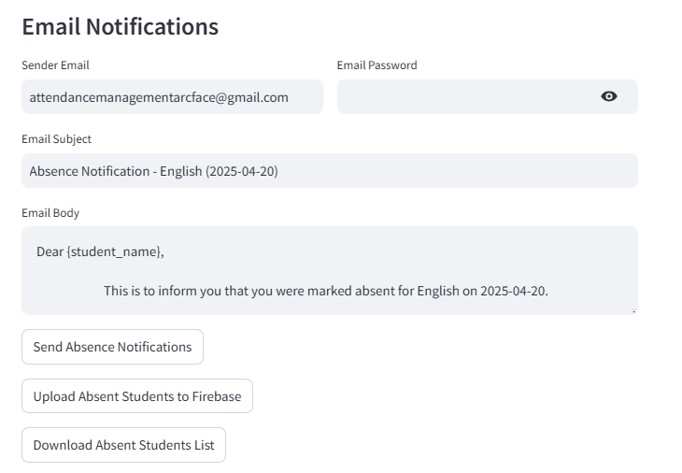
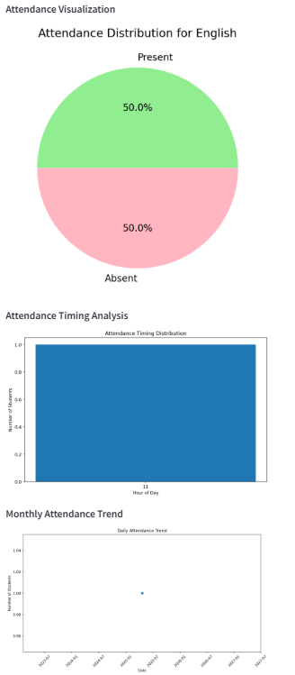
Email Notifications and Analytics :

Slide 20
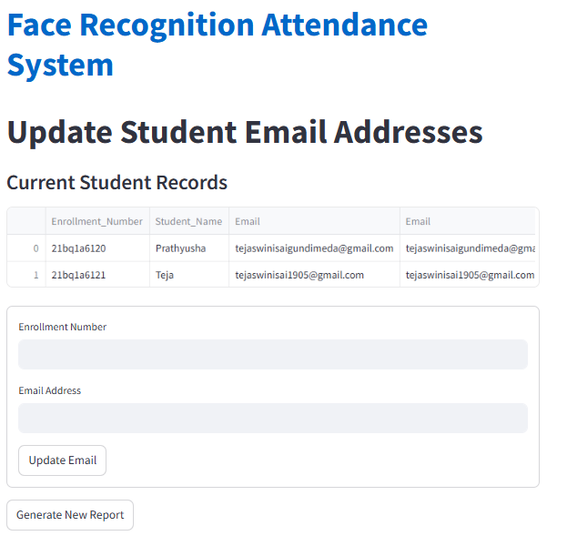
Update Emails :

Slide 21
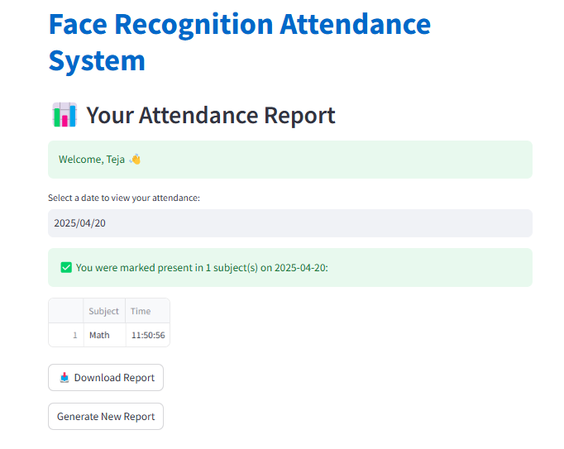
Student Login :

Slide 22
CONCLUSION
The Realtime Face Attendance System using Arcface offers a modern, efficient, and automated solution to attendance management. By leveraging real-time facial recognition and AI-based analytics, it ensures accuracy, scalability, and efficiency. The project eliminates manual errors, enhances accountability, and provides actionable insights through advanced visualizations.

Slide 23
THANK YOU

